Slide 1

Operating Systems
Designed by Mr. M Mudassar

Slide 2
Outline
Process
Threads
CPU Scheduling
Process Synchronization
Deadlocks
Memory Management
Virtual Memory
File System
I/O System
Disk Management
Protection
Security

Slide 3
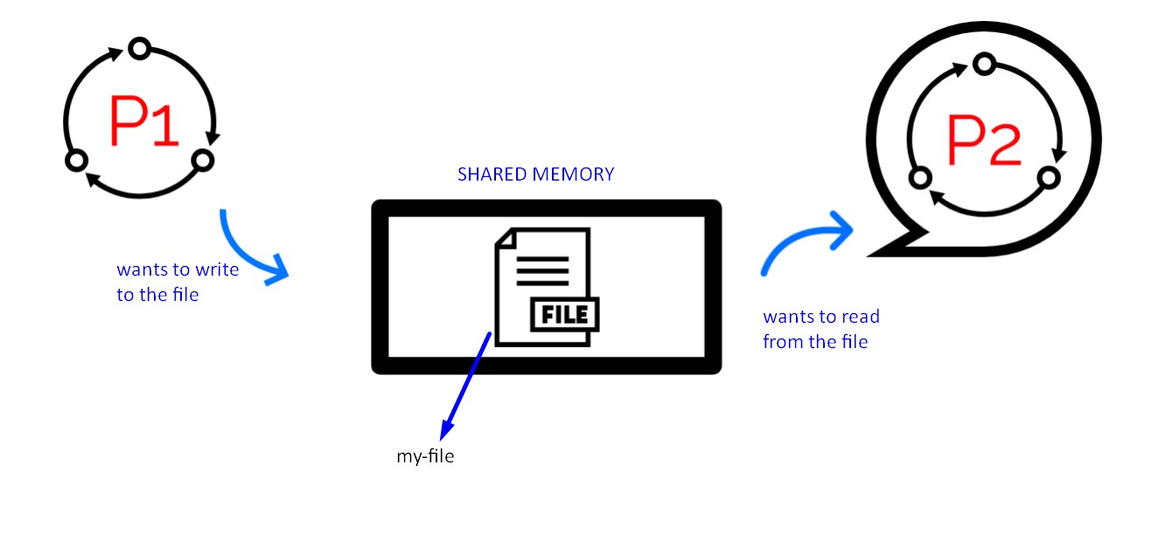
Process Synchronization

Slide 4
Process Synchronization
Producer | Consumer | Dry run
repeat … produce an item in nextp … while counter = n do no operation buffer[in] = nextp in = (in+1) mod n counter = counter + 1 until false | repeat while counter = 0 do no operation nextc = buffer [out] out = (out-1) mod n counter = counter - 1 … Consume the item in nextc … until false | Counter = 5 T0: producer execute R1 = counter {R1 = 5} T1: producer execute R1 = R1+1 {R1 = 6} T2: consumer execute R2 = counter {R2 = 5} T3: consumer execute R2 = R2 – 1 {R2 = 4} T4: producer exec. counter = R1 {counter = 6} T5: consumer exec. counter = R2 {counter = 4}
Code for procedure R1 = counter R1 = R1 + 1 counter = R1 | Code for consumer R2 = counter R2 = R2 – 1 counter = R2

Slide 5
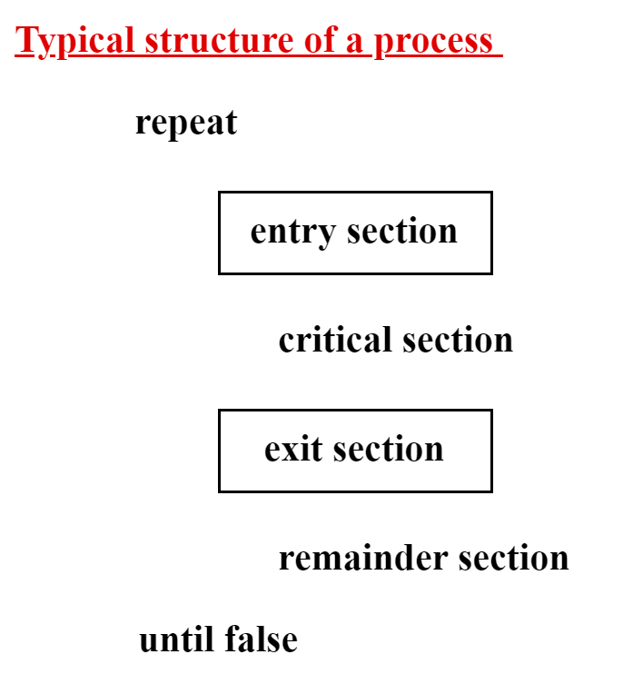
Process Synchronization – Critical Section Problem
A solution to the critical section problem must satisfy the following three requirements:
Mutual Exclusion
Progress
Bounded Waiting

Slide 6
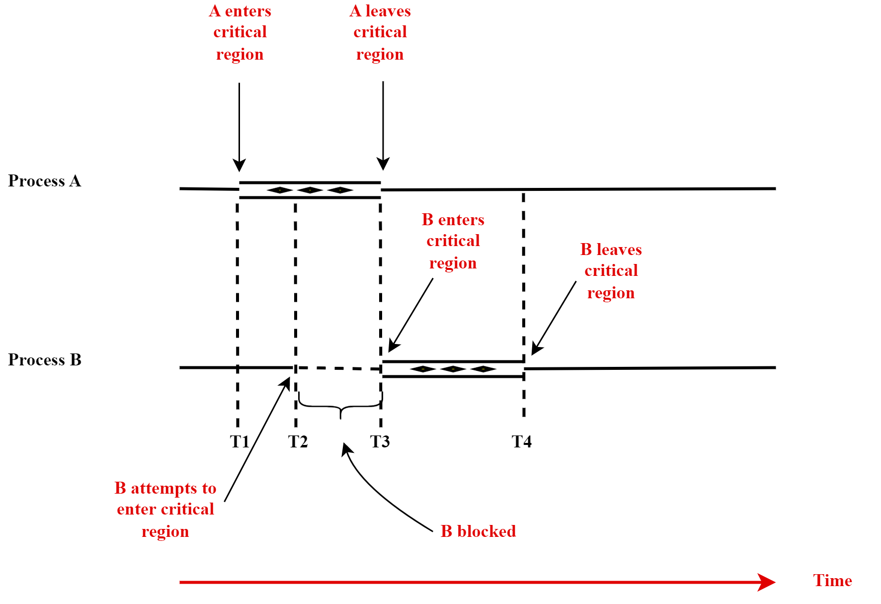
Process Synchronization – Mutual Exclusion using Critical Region

Slide 7
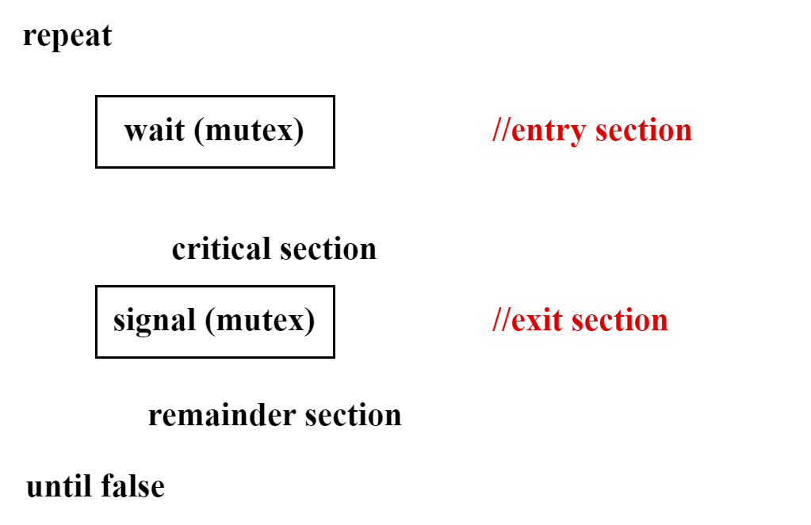
Process Synchronization – Semaphore
wait(S): while S ≤ 0 do no operation
S = S – 1
Signal(S): S = S + 1
P1:
Statement1
Signal(mutex)
P2:
Wait(mutex)
Statement2
Semaphore variable (Mutex) = 0 or 1

Slide 8
Record Based Semaphore
type semaphore = record value = integer LP = List of processes end | 1 | CS is empty, waiting queue is empty
 | 0 | CS is occupied, waiting queue is empty
 | -3 | CS is occupied, 3 processes in queue
 | -4 | CS is occupied, 4 processes in queue
The semaphore operations can be defined as:
Wait(S): S.value = S.value – 1 if S.value < 0 then begin add this process to S.LP end | Signal(S): S.value = S.value + 1 if S.value ≤ 0 then begin remove a process from S.LP end

Slide 9
Binary Semaphore
type binary_semaphore = record value: (0,1) Queue = List of processes end var S: binary_semaphore
The semaphore operations can be defined as:
Wait B(S): if S.value = 1 then S.value=0 else begin place this process to S.Queue block this process end | Signal B(S): if S.Queue is empty then S.value = 1 else begin remove a process from S.Queue place process P on ready list end

Slide 10
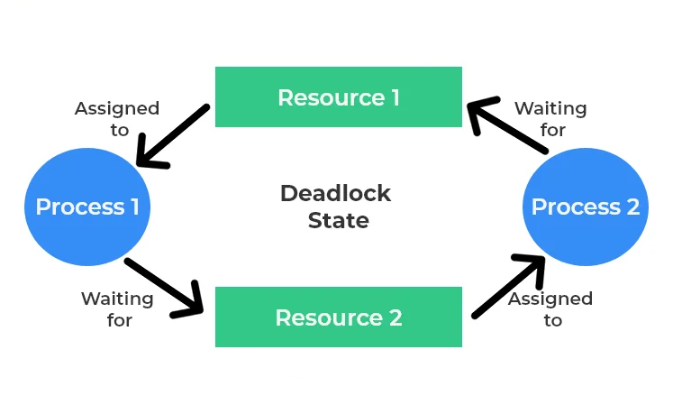
Process Synchronization – Deadlock and Starvation
Improper usage of semaphore creates deadlock and starvation. (variable S and Q values?)
For example, the two concurrent processes misusing the semaphore variable such as below:
P1 P2
Wait(S) Wait(Q)
Wait(Q) Wait(S)
… …
Signal(S) Signal(Q)
Signal(Q) Signal(S)
Wait(S): while S≤0 do no-operation
S=S-1
Signal(S): S=S+1

Slide 11
Classical Problems in Process Synchronization – The Bounded Buffer Problem
The structure of producer process:
Three variables: mutex=1, empty=n, full=0
Repeat
…
Produce an item in nextp
…
Wait(empty)
Wait(mutex)
…
Add nextp to the buffer // CS
…
Signal(Mutex)
Signal(full)
Until End
The structure of consumer process:
Repeat
Wait(full)
Wait(mutex)
…
Remove an item from the buffer to nextc // CS
…
Signal(mutex)
Signal(empty)
…
Consume the item in nextc
Until End

Slide 12
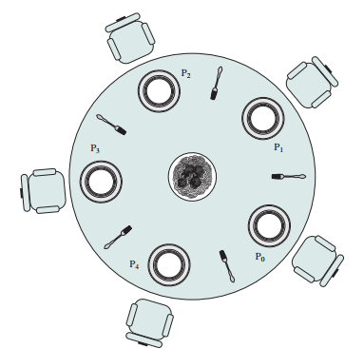
Classical Problems in Process Synchronization – The Dinning Philosopher Problem
The Structure of Dinning Philosopher i:
Variables: chopstick array [0..4] of semaphore, all five locations initialized with 1.
Repeat
Wait(chopstick[i])
Wait(chopstick[(i+1) mod 5])
…
Eat
…
Signal(chopstick[i])
Signal(chopstick[(i+1) mod 5])
…
Think
…
Until End

Slide 13
Classical Problems in Process Synchronization – The Dinning Philosopher Problem
Remedies for the solution of Dinning Philosopher Problem:
Maximum four philosophers can access the chopstick at a time.
A philosopher will start eating if and only if both chopsticks(left and right) are available.
The philosopher with even number will choose the right chopstick, and the odd number will choose the left chopstick.

Slide 14
Classical Problems in Process Synchronization – Readers and Writers Problem
Remember:
ar: number of active reader.
rr: number of running reader.
aw: number of active writer.
rw: number of running writer.
Request resource
Use resource
Release resource
Correctness Criteria:
Scheduling of waiting process
0 <= rr <= ar
0 <= rw <= aw
Mutual exclusion of running processes
Not (rr > 0 & rw>0)
No deadlock of active processes
(rr = 0 & rw = 0 ) & (ar > 0 || aw > 0) implies
(rr > 0 || rw > 0 ) within a finite time
Writer will have the priority over readers

Slide 15

References
https://youtu.be/3Kp4GlKqefo
https://youtu.be/HthluCAXfxs
https://youtu.be/QYheRZ-S7SY
https://youtu.be/jM9_u__dr2g
https://youtu.be/5SBe6rIi8nI
https://youtu.be/o1Joyj_Ow6M
https://youtu.be/4Mw_a3IlldM
https://youtu.be/DLkrIRxuy7k
https://youtu.be/0g4Z_Ws9y6k
https://youtu.be/cGM5QtcS4KE

Slide 16
Thank You(Q & A)

